Slide 1
Machine Learning

Slide 2
Announcements
Assignment 2 announced

Slide 3
Macro F1
 | Precision | Recall | F1 score
Chocolate
Oatmeal
Peanut Butter
Notes:
Avg Precision, Avg Recall, Avg, F1 score

Slide 4
Weighted F1
 | # samples | Precision | Recall | F1 score
Chocolate
Oatmeal
Peanut Butter
Notes:
n1Pre1+n2Pre2+n3Pre3/n1+n2+n3

Slide 5
Micro-F1
Predicted Actual | Chocolate | Oatmeal | Peanut Butter
Chocolate | 100 | 10 | 50
Oatmeal | 20 | 200 | 20
Peanut Butter | 20 | 20 | 300
Notes:
Same as micro-P, micro-Recall, accuracy

Slide 6
ROC curve
Threshold dependant TPR vs FPR
TPR= TP/ P
FPR=FP/N

Slide 7
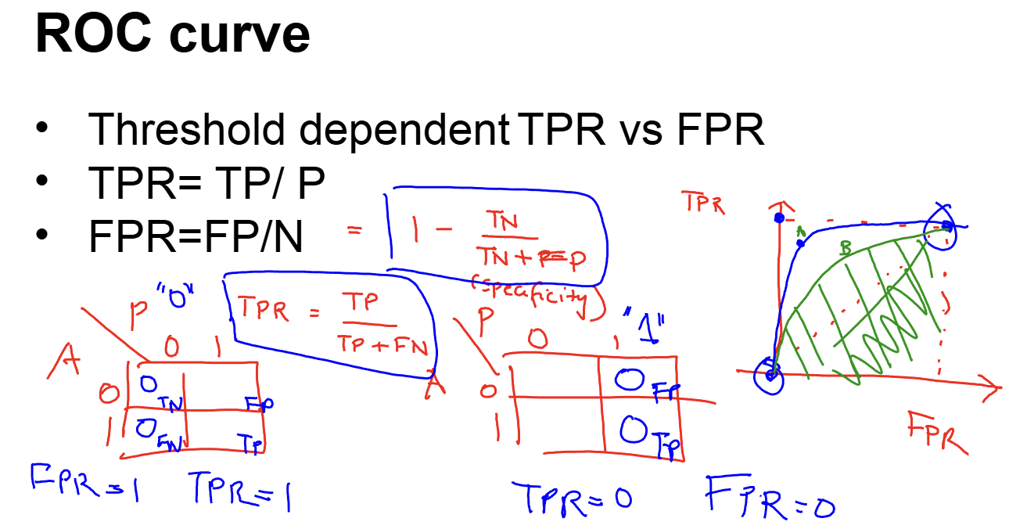
Threshold dependant TPR vs FPR
TPR= TP/ P
FPR=FP/N

Slide 8
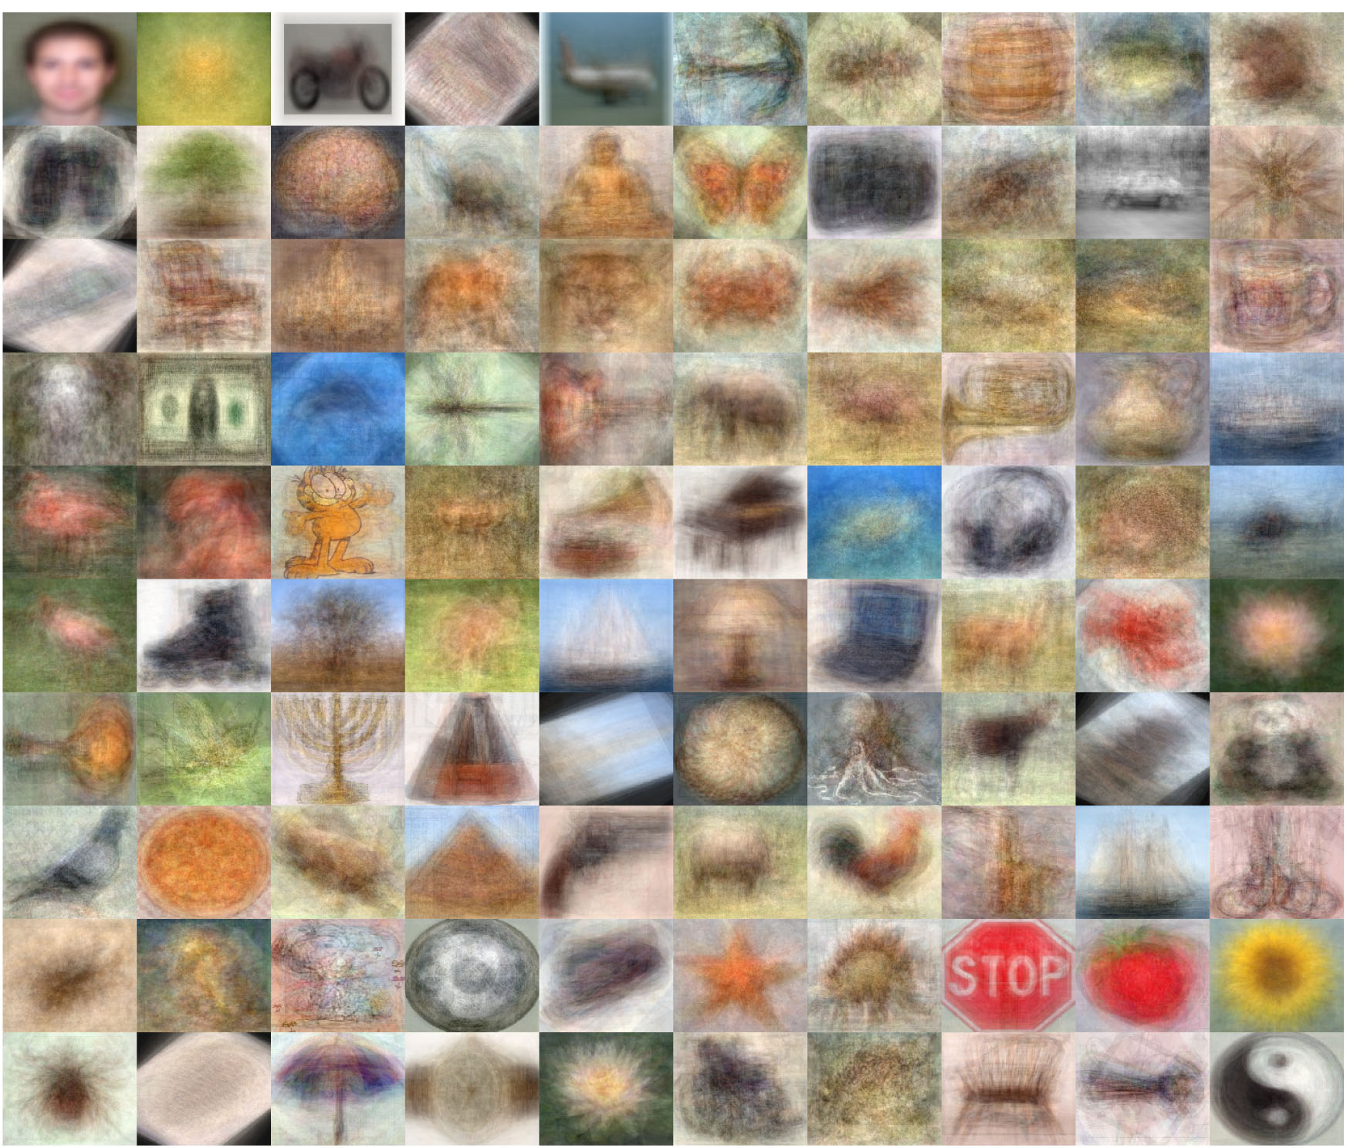
Computer Vision Use Case
101 Categories
Each category: 50+ images
Consider a 100 X 100 image (RGB)
http://www.vision.caltech.edu/Image_Datasets/Caltech101/
Notes:
Complex non linear hypotheses

Slide 9
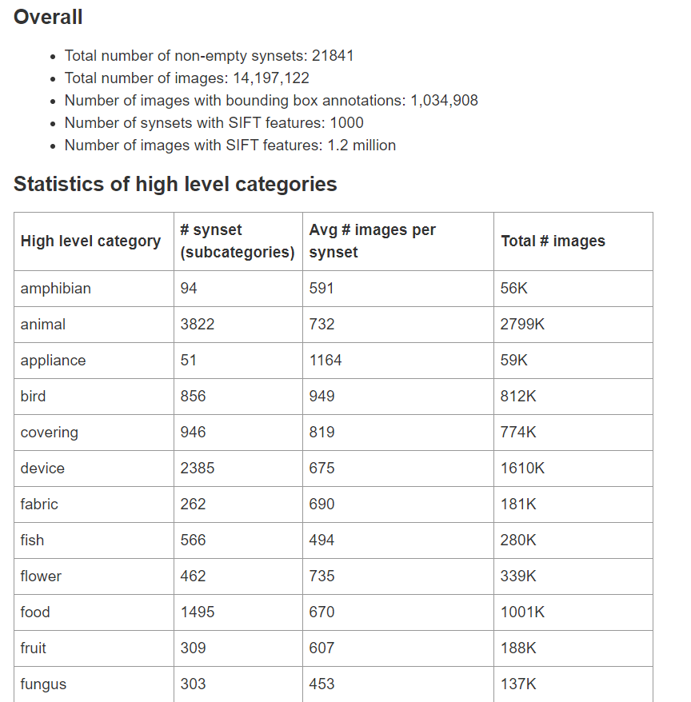
ImageNet
Notes:
2016

Slide 10
Neural Networks
Tries to mimic the brain
Idea is that every part of the brain has a specific purpose; the brain distributes the tasks
source: http://cs.stanford.edu/people/eroberts/courses/soco/projects/neural-networks/
Notes:
dendrites feed the input to the neurons and axons are help the neurons “talk” to each other through electrical pulses
It can adapt/ learn to perform different tasks> Can it relearn?

Slide 11
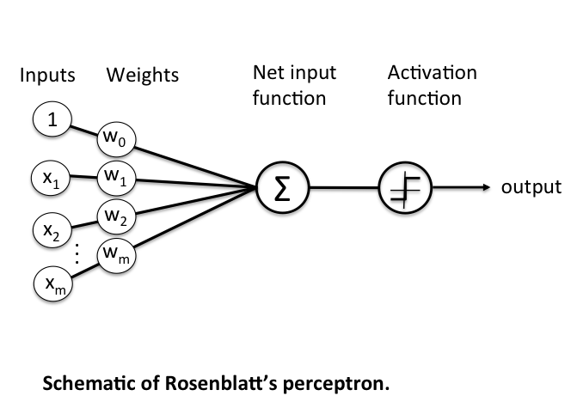
Single Perceptron
1943, Warren McCulloch and Walter Pitts introduced one of the first artificial neurons
In the late 1950s, Frank Rosenblatt and several other researchers developed a class of neural networks called perceptrons
Notes:
chrome-extension://ohfgljdgelakfkefopgklcohadegdpjf/http://hagan.okstate.edu/4_Perceptron.pdf

Slide 12
Single Perceptron

Slide 13
Single Perceptron

Slide 14
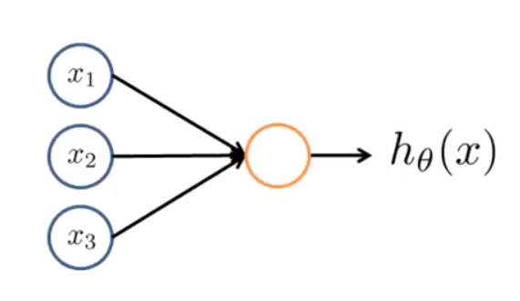
Neural Networks
x0
One neuron system
Activation function
The parameters (thetas) also called weights in some textbooks
Notes:
Perceptron
Mcculoch Pitts
Rosenblatt

Slide 15
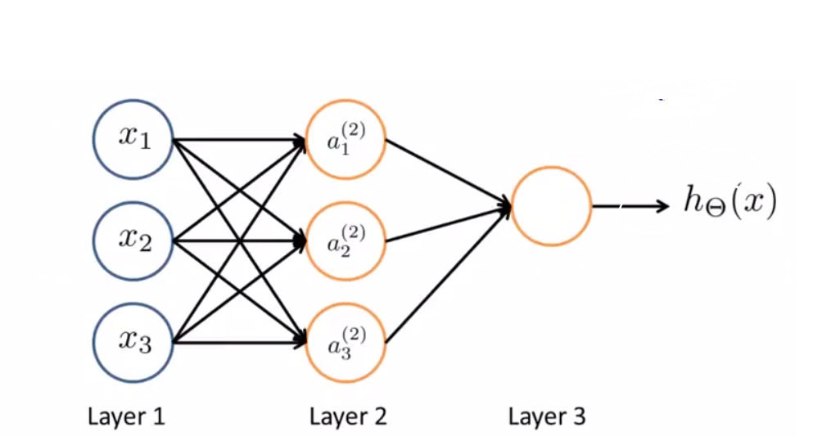
Neural Networks
Notes:
we have input features x1 x2 x3 , can add x0 and can also add a bias node a0 (2) The first layer is called the input layer The final layer is called the output layer
Layer 2 is called the hidden layer == intuition you can see the inputs and the outputs, so are hidden from us, We can have multiple hidden layers. so all the layers between input and output layers
What is this NN doing?

Slide 16
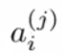
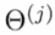
Some more Notation
= activation function for layer j and unit/ node i
= matrix of the weights controlling the mapping of the data flow from layer j to layer j+1

Slide 17
Some more Notation
= activation function for layer j and unit/ node i
= matrix of the weights controlling the mapping of the data flow from layer j to layer j+1

Slide 18
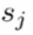
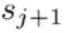
Some more Notation
If a network has units in layer j and units in layer j+1, then
will be of dimension X ( +1)
Notes:
first hidden unit ‘a’ superscript (1)
3 input units and 3 hidden units, so dimension of theta (1) = 3 X 4
let’s write all the equations together. Also be very clear about the notation
Final output unit h(x) a3 (1) === we see the a, (2) is the matrix

Slide 19
Some more Notation
Notes:
Theta21, superscript 1.

Slide 20
Some more Notation
Notes:
Theta21, superscript 1.

Slide 21
Some more Notation
Notes:
Theta21, superscript 1.

Slide 22
Some more Notation
Notes:
Theta21, superscript 2.

Slide 23
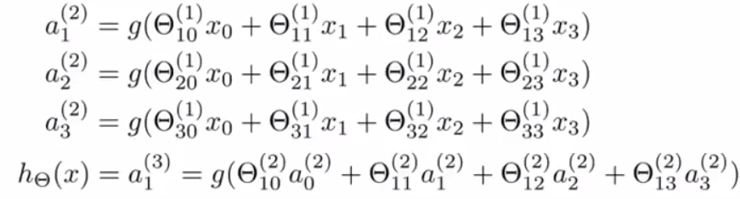
Hide Slide
If a network has units in layer j and units in layer j+1, then
will be of dimension X ( +1)

Slide 24
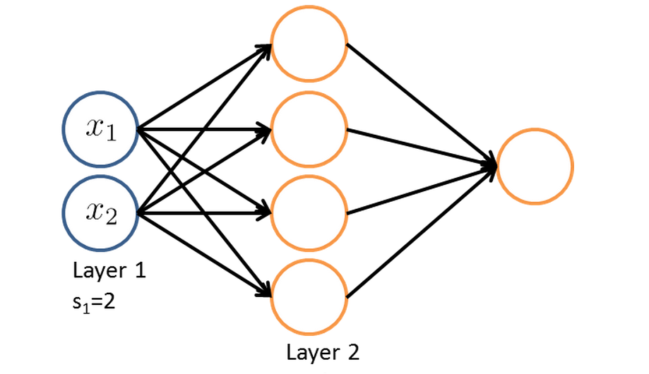
Dimensions?
Notes:
What is the dimensionality of theta (1)? 4X 3
theta (2): 1X5

Slide 26
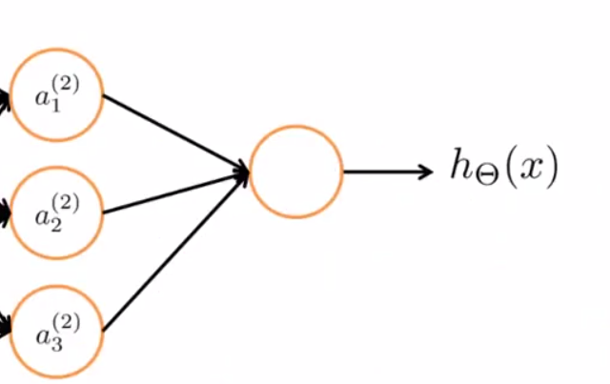
What does this look like?
What is the difference?
Notes:
suppose i just look at the right side. what does it look like?
h-theta(x) = g(theta10(2)*a0 (2) + theta11(2)*a1(2) +theta12(2)*a2(2) + theta13(2)*a3(2) ) Logistic, except that rather than using the original features x0, x1,x2,. it is using the values a1, a2, a3
It gets to learn its own features a1, a2, a3… so it can learn some interesting complex features rather than constrained to use the input features, so it has more flexibility So this hidden layer add more complexity to the model so we will understand it better

Slide 27
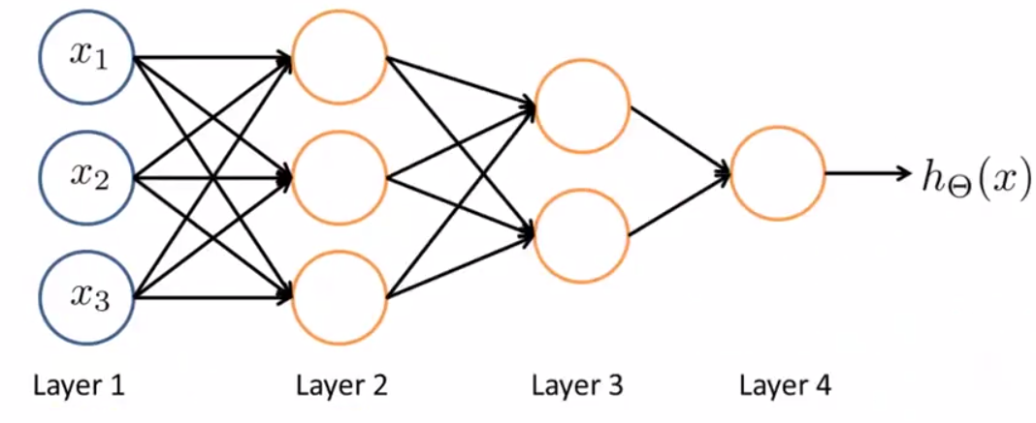
Different Architectures
Notes:
what does the architecture in this slide refer to?
The way the neurons are connected ==# hidden layers, # hidden nodes in each layer === more layers, more complexity How many hidden layers?

Slide 28
Multi-class Classification
{pedestrian, car, two wheeler, truck}
Notes:
car == [0100]...so it is like 1 vs all

Slide 29
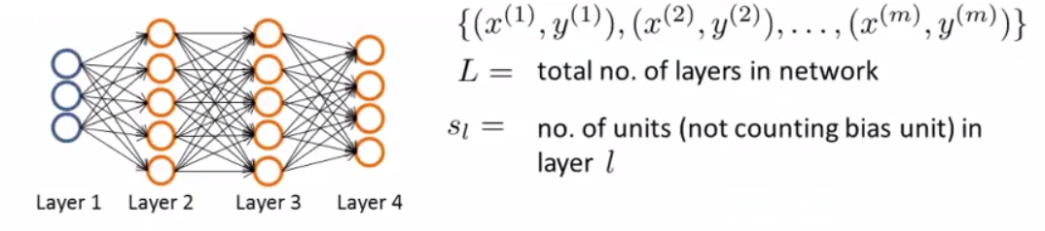
Cost Function For NN

Slide 30
Cost Function For NN
S1 = ?
S2 = ?
S3 = ?
S4 = ?
Notes:
3 5 5 4

Slide 31
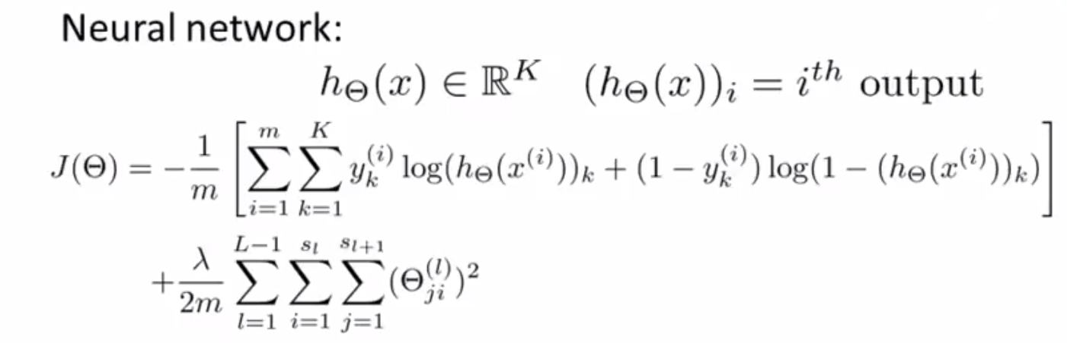
Cost Function
Notes:
Min J(theta), need to compute j(theta), partial of J wrt theta. Several h(theta), one for each class

Slide 32
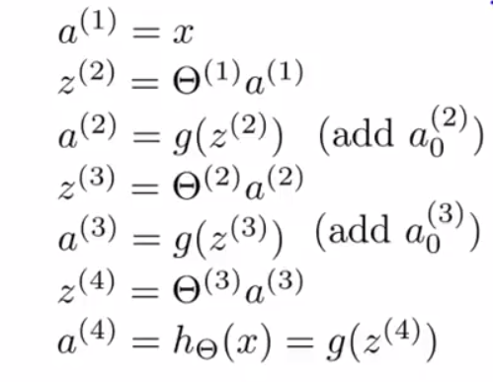
Forward Propagation with one sample
Notes:
Have to do each for each training sample

Slide 34
Cost Function For NN

Slide 35
Cost Function For NN
S1 = ?
S2 = ?
S3 = ?
S4 = ?
Notes:
3 5 5 4, 74 (# wts). K < sq-rt (M)

Slide 36
Forward Propagation with one sample
Notes:
Have to do each for each training sample

Slide 38
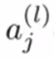
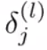
Backpropagation
Want to “backpropagate” the error from output towards input
Recall
: activation for hidden layer ‘l’ and node ‘j’
: error associated with node ‘j’ in layer ‘l’
Notes:
Represent error of node j in layer l. Also, show Gradient descent for theta ij

Slide 39
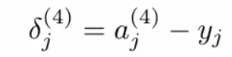
Backpropagation
Want to “backpropagate” the error from output towards input
Recall
: activation for hidden layer ‘l’ and node ‘j’
: error associated with node ‘j’ in layer ‘l’
Notes:
What is the known error? aj(4) is nothing bu the hypothesis function since this is the output node

Slide 40
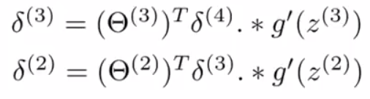
Backpropagation
Recall
: activation for hidden layer ‘l’ and node ‘j’
: error associated with node ‘j’ in layer ‘l’
Notes:
Elementwise multiplication. Give example.

Slide 41
Backpropagation
Recall
: activation for hidden layer ‘l’ and node ‘j’
: error associated with node ‘j’ in layer ‘l’
a⁽³⁾ * (1 – a⁽³⁾)
Notes:
1 here is a vector of 1’s of same dimension as a(3). Is there a delta(1) term? No

Slide 42
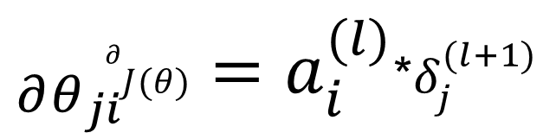
Taking Partial Derivative of Cost
${}_{∂θ_{ji}}^{∂}{J(θ)}=a_{i}^{(l)}$*$δ_{j}^{(l+1)}$
Notes:
Not getting into details, ignoring lambda for now. Draw Theta ji going from a i(l) to delta j (l+1)

Slide 43
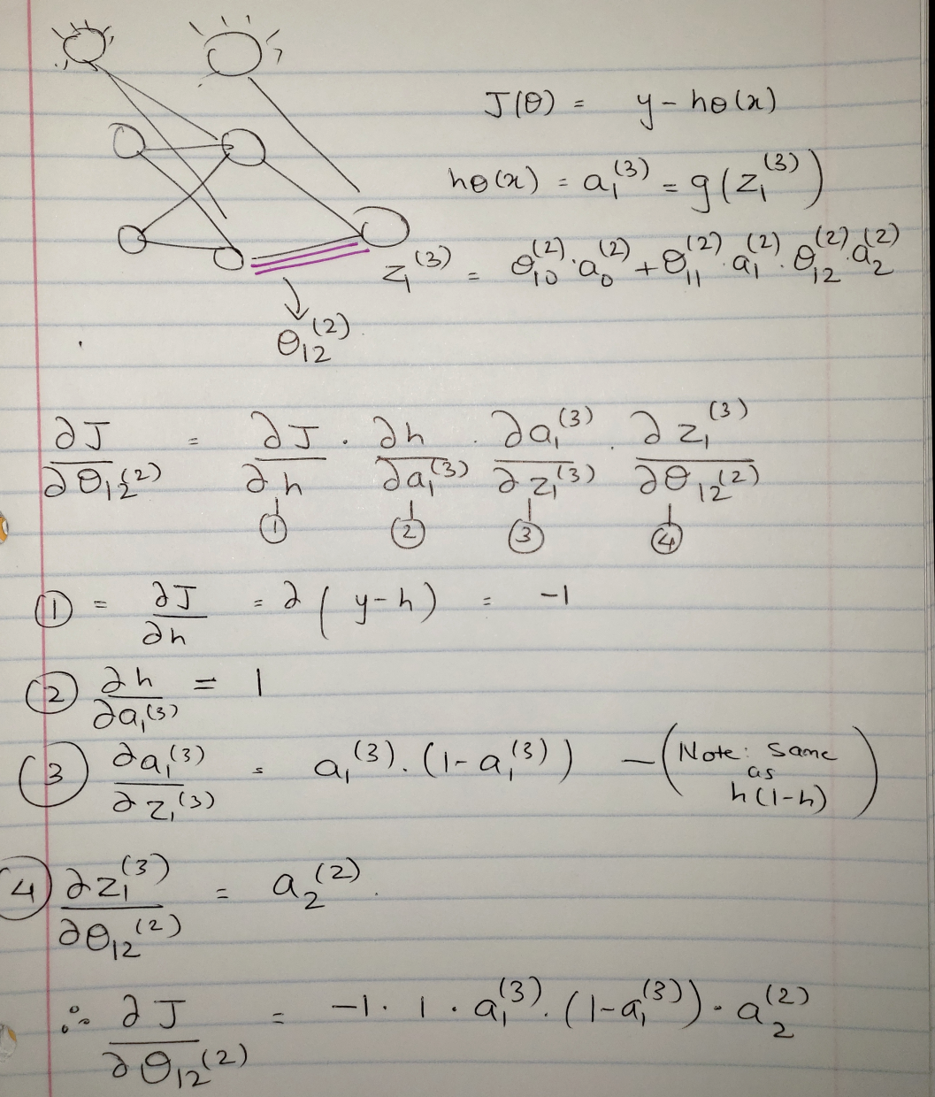

Slide 44
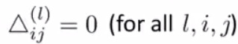
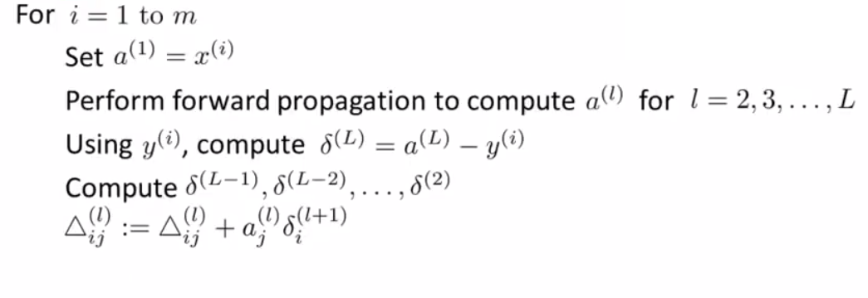
Implementation
Notes:
Capital delta is the triangle, Accumulators, forward prop, then backward prop.

Slide 45
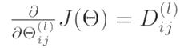
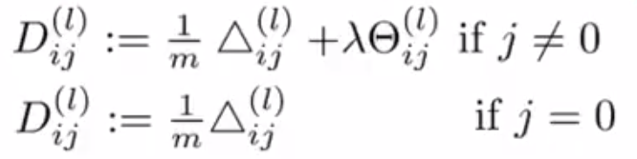
Implementation
Notes:
D are the partial derivative terms. j=0 are the bias terms. Regularization here

Slide 46
Thoughts?

Slide 47
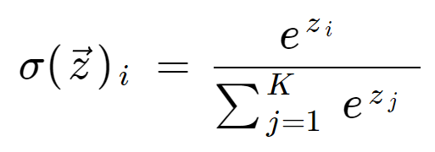
Activation Functions
Soft Max
https://www.desmos.com/calculator
Penultimate layer: normalization
Notes:
-1,3,.5,10 =>0,0,0,1

Slide 48
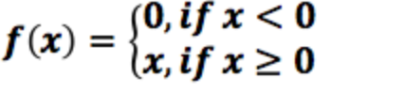
Activation Functions
Rectified Linear Unit
Curse of Dimensionality
Notes:
High dimension, data sparsity, infinite training for “infinite” features

Slide 49
Activation Functions
Rectified Linear Unit
Curse of Dimensionality
Leaky ReLu
Notes:
High dimension, data sparsity, infinite training for “infinite” features

Slide 51
Weight Initialization
Suggestions
(Theta)ij ~ N(mean,std) , mean=0 , std=sqrt(2/fan_in).

Slide 52
NN Architecture choices
N input features, K classes

